Slide 1
Car Park Availability Analysis
&
Predictive Modelling
Group - DS - 07
Chow ,Michael
Lee Yat Shun, Jasper
Mohammad Shehzaad
Hindy Yuen Shing Yan

Slide 2
Workflow
Problem Introduction
Problem Statement
Datasets
External Datasets
Data Preprocessing
Data Cleaning
Feature Engineering
Dimensionality Reduction
Exploratory Data Analysis
Machine Learning Models
Model Evaluation
Future Development
Enhancing Predictions Accuracy
Model Selection
Hyperparameters Tuning
Practical Usages

Slide 3
Problem Introduction

Slide 4
Problem Background
Objective: Car Park Availability Analysis and Predictive Modelling across all the HK Districts
Problem: Regression (Supervised Learning)
User input:
Full date
Time (Rounded off to the nearest 15 min interval)
District
Output (Prediction):
List of car park with the corresponding vacancy prediction for enquired district and time

Slide 5
Dataset Information
 | Dimensions | Source | Extraction Methodology
CarPark vacancy (01/05/2021 - 31/05/2021) | (973479, 6) | data.one.gov.hk | JSON requests Pandas
Basic info | (327, 22)
Car parks that fulfill criteria: 148

Slide 6
Dataset Information - External
Car parks that fulfill criteria: 148
 | Dimensions | Source | Extraction Methodology
population2020 | (18, 8) | Census and Statistics Dept. | Customized and downloaded directly
population_sex | (252, 8)
area | (18, 2) |  | Downloaded directly (JSON, requests, Pandas libraries,geopandas)
district_borders | (18, 5) | DATA.GOV.HK
Notes:
Source: https://data.gov.hk/en-data/dataset/hk-td-tis_5-real-time-parking-vacancy-data

Slide 7
Data Preprocessing

Slide 8
Data Preprocessing - Data Cleaning
Label Encoding categorical features such as “park_id”
Imputing Missing Values
9 car parks’ districts are missing
Directly recovered via: http://www.gohk.gov.hk/chi/welcome/index.html
Dropping unnecessary features/instances:
Duplicates
Outside the desired time period
High Pearson’s R
Amount of Variation

Slide 9
Data Preprocessing - Feature Engineering
Districts -> zones (HK Island, KL, etc.)
Timestamp -> ‘day_of_week’, ‘hours’, ‘minute’ -> Cyclical Encoding
Remarks -> ‘Tesla Superchargers’
Male-to-Female ratio
Population /Area -> Population Density
Public holidays
Notes:
Capture periodicity

Slide 10
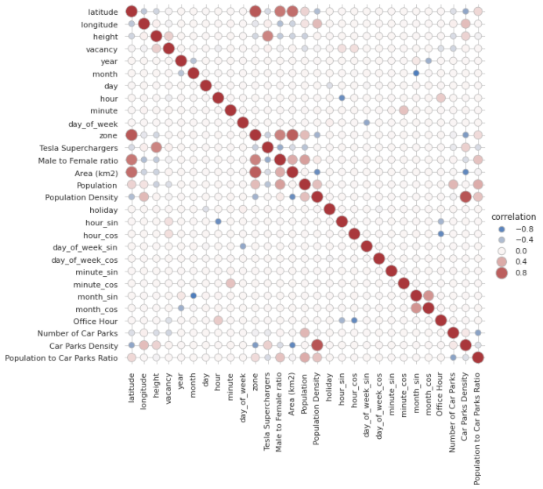
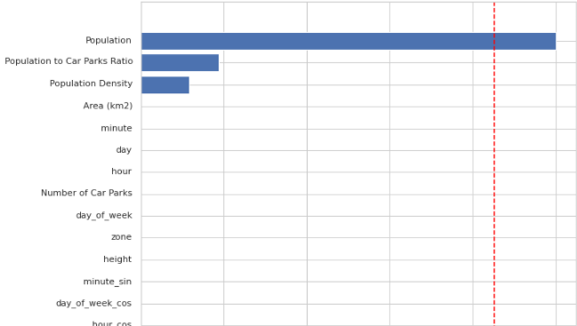
Data Preprocessing - Dimensionality Reduction
Pearson’s R
Standard Deviation
“Population”,
“Population to Car Parks Ratio”
“Population Density”
shows obvious level of variance
No feature shares strong corr. with the target.
Strong corr.:
1) month - month_sin 2) Population Density - Car Parks Density 3) latitude - zone
Notes:
zone - Area (km2)
Car Parks Density - Area (km2)
hour_cos - Office Hour
Area (km2) - Population Density
hour - hour_sin
Area (km2) - latitude

Slide 11
Exploratory Data Analysis

Slide 12
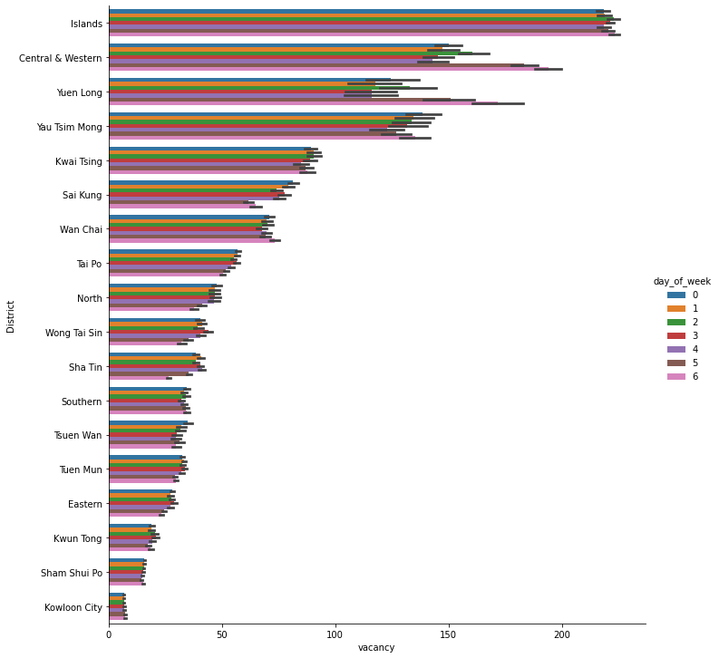
Exploratory Data Analysis
Figure
vacancies by days per districts
Findings:
Winner: Islands

Slide 13
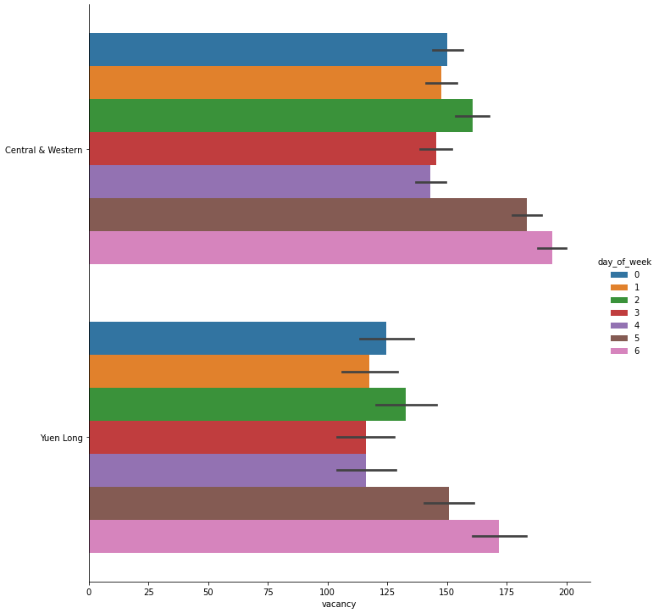
Exploratory Data Analysis
Figure
vacancies by days per districts
Findings:
Central & Western,
Yuen Long,
have slightly more (30-40) vacancies on weekends

Slide 14
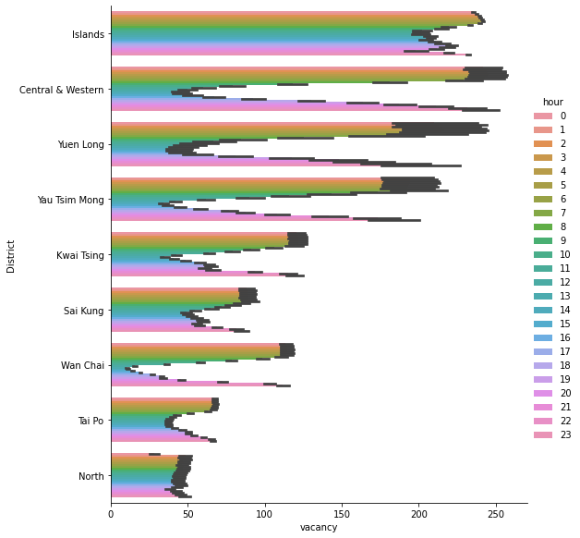
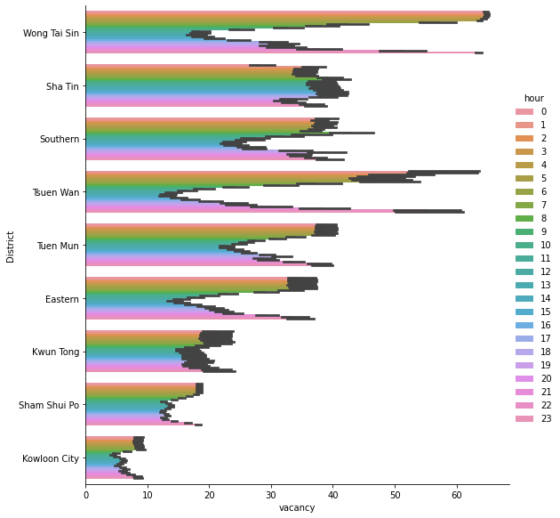
Exploratory Data Analysis
vacancies by hours per districts
Findings:
Hour 13 - 16: Lowest vacancies
North,
Islands,
Kwun Tong:
Intra-day vacancies do not vary much
Notes:
And if we plot the vacancies vs the hours instead of day of weeks, we can see that the diff in vacancies per districts actually become even more obv

Slide 15
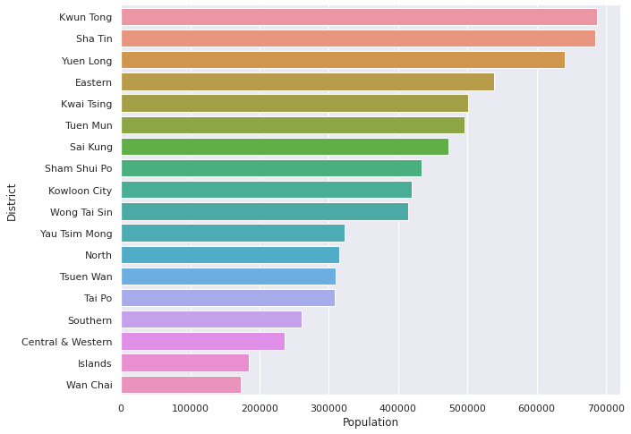
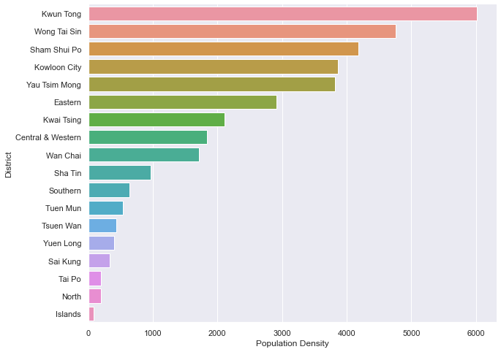
Exploratory Data Analysis
Population
Population Density
Kwun Tong -> Kwun Tong
Sha Tin -> Wong Tai Sin
Yuen Long -> Sham Shui Po
Notes:
Top 3 most populated districts

Slide 16
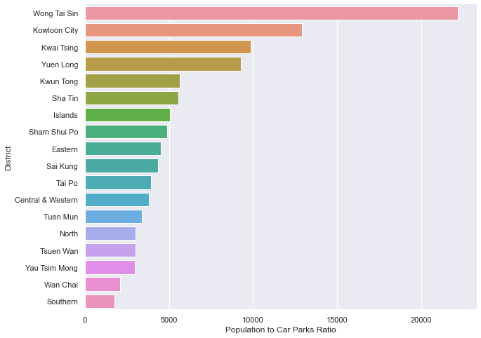
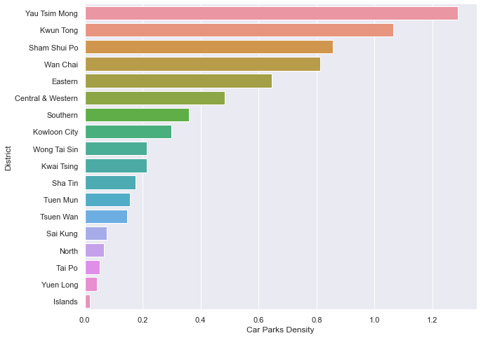
Exploratory Data Analysis
Population-to-Car Parks Ratio
Car Parks Density
Wong Tai Sin: highest Population-to-Car Parks Ratio
Kowloon City, Kwai Tsing and Yuen Long roughly shares similar Population-to-Car Parks Ratio
Notes:
Both of the Differences between districts: Significant
Might be useful

Slide 17
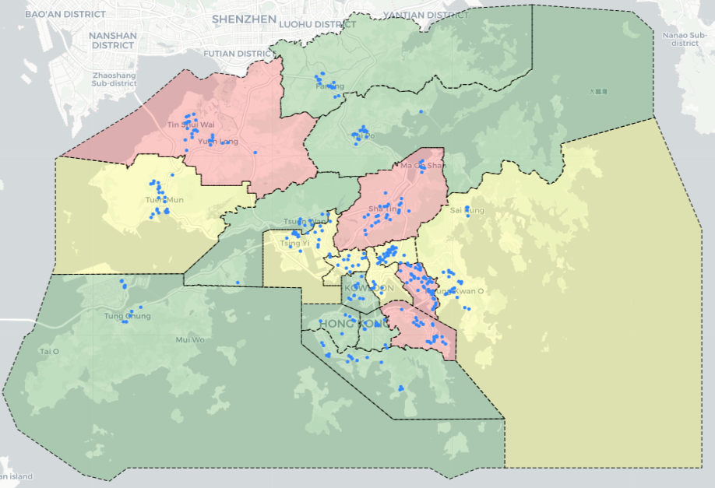
Exploratory Data Analysis
Figure
Car parks and population distribution overlaid
Findings:
Population Density:
positively correlated with number of car parks, rather than the area of the districts.

Slide 18
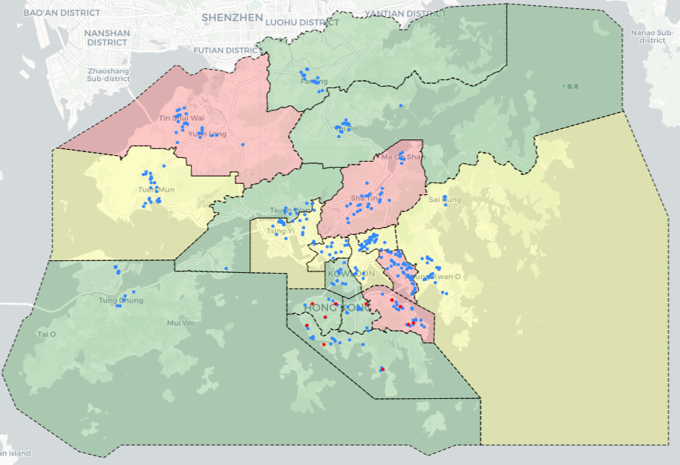
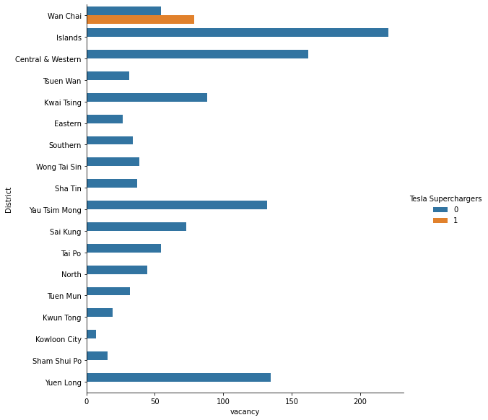
Exploratory Data Analysis
Figure
Car parks and population distribution overlaid (EV Charging Station highlighted)
Findings:
All EV Charging Station are located in HK Island.
Wan Chai: only district provide slots with Tesla Superchargers.

Slide 19
Features Selected
Compulsory:
Park_id
day_of_week
hour
minute
Created/Selected:
Tesla Superchargers
Area (km2)
District
Population
Population Density
holiday
Male to Female ratio
zone

Slide 20
Machine Learning Models

Slide 21
Machine Learning Models
 | Speed | Overfitting/Underfitting | Performance
Random Forest Regressor |  | Prone to overfitting | Steady
Linear Regressor |  | May overfit without regulation | Poor with high dimensional data
AdaBoostRegressor |  | Rarely Overfit/Underfit | Good
CatBoost Regressor |  | Rarely Overfit/Underfit | Good
XGB Regressor |  | May overfit without regulation | Good
LightGBM Regressor |  | Rarely Overfit/Underfit | Good

Slide 22
Machine Learning Models
 | Speed | Overfitting/Underfitting | Performance
Random Forest Regressor |  | Prone to overfitting | Steady
Linear Regressor |  | May overfit without regulation | Poor with high dimensional data
AdaBoostRegressor |  | Rarely Overfit/Underfit | Good
CatBoost Regressor |  | Rarely Overfit/Underfit | Good
XGB Regressor |  | May overfit without regulation | Good
LightGBM Regressor |  | Rarely Overfit/Underfit | Good

Slide 23
Machine Learning Models
 | Speed | Overfitting/Underfitting | Performance
Decision Tree Regressor |  | May underfit with proper tuning | Worst than Random Forest Regressor
Extra Trees Regressor |  | Prone to overfitting | Worst than Random Forest Regressor
KNN Regressor |  | May underfit with proper tuning | Usually poor
Radius Neighbors Regressor |  | May underfit with proper tuning | Usually poor
Support Vector Regressor |  | May overfit without proper tuning | Perform well with small amount of data

Slide 24
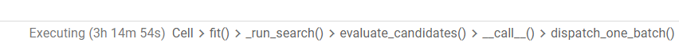
Machine Learning Models - Limitation of model
Support Vector Regressor
Problem:
Processing time extremely slow
Executing time was over 3 hours (without considering polynomial kernel function)
Conclusion:
Model cannot be presented and therefore will be included in future development stage

Slide 25
Model Evaluation

Slide 26

Model Evaluation
Cross Validation Scores (Training) | Negative Mean Absolute Error | Negative Mean Squared Error | R2
XGBRegressor | -24.378 | -1581.384 | 0.812
AdaBoostRegressor | -54.467 | -4577.359 | 0.465
LGBMRegressor | -9.553 | -235.217 | 0.972
CatBoostRegressor | -6.493 | -142.134 | 0.983
Decision Tree Regressor | -4.674 | -133.617 | 0.984
Random Forest Regressor | -4.105 | -94.101 | 0.989

Slide 27
Model Evaluation
Scores (Testing) | Mean Absolute Error | Mean Squared Error | R2
XGBRegressor | 22.524 | 1447.011 | 0.826
AdaBoostRegressor | 57.749 | 4991.048 | 0.400
LGBMRegressor | 9.227 | 223.574 | 0.973
CatBoostRegressor | 6.086 | 127.645 | 0.985
Decision Tree Regressor | 4.556 | 124.18 | 0.985
Random Forest Regressor | 4.071 | 92.331 | 0.989

Slide 28
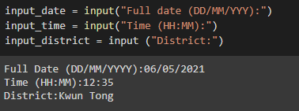
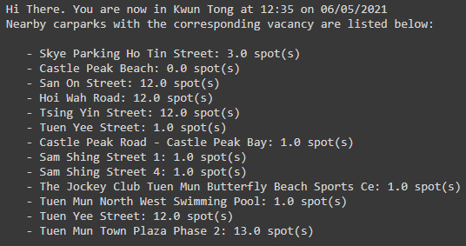
Deployment and result
Deployed Model:
Random Forest Regressor
User input:
Date: DD/MM/YYYY
Time: HH:MM
Round off to every 15 mins for prediction
District: Name of the district
Output return:
List of Car park vacancy in the district
User input
Enquiry result

Slide 29
Future Development

Slide 30
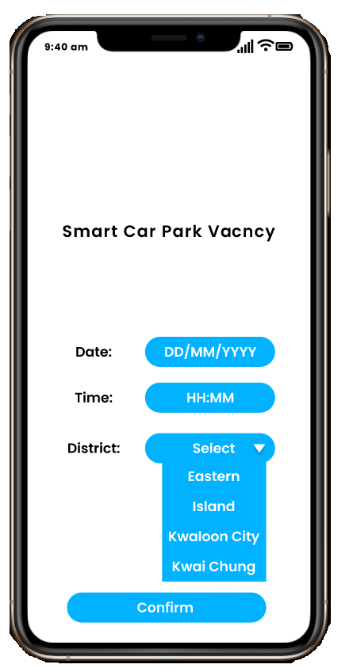
Future Development: Practical Usages
Deploying on:
Web App
Mobile App
How it works:
Applying cloud DB storage
Auto data preprocessing
Dynamically retraining models with continuous learning
Managing and monitoring models for model drift, bias and risk on dashboard
Collect enquiry data on parking demand

Slide 31
Future Development: Enhancing Prediction Accuracy
Adding more training features:
Median salaries: Richer -> more cars
Weather: Rainy vs sunny - affect traffics
Pre and post Pandemic figures - influence on car park occupancy
Private parking slots
Fees of car parks

Slide 32
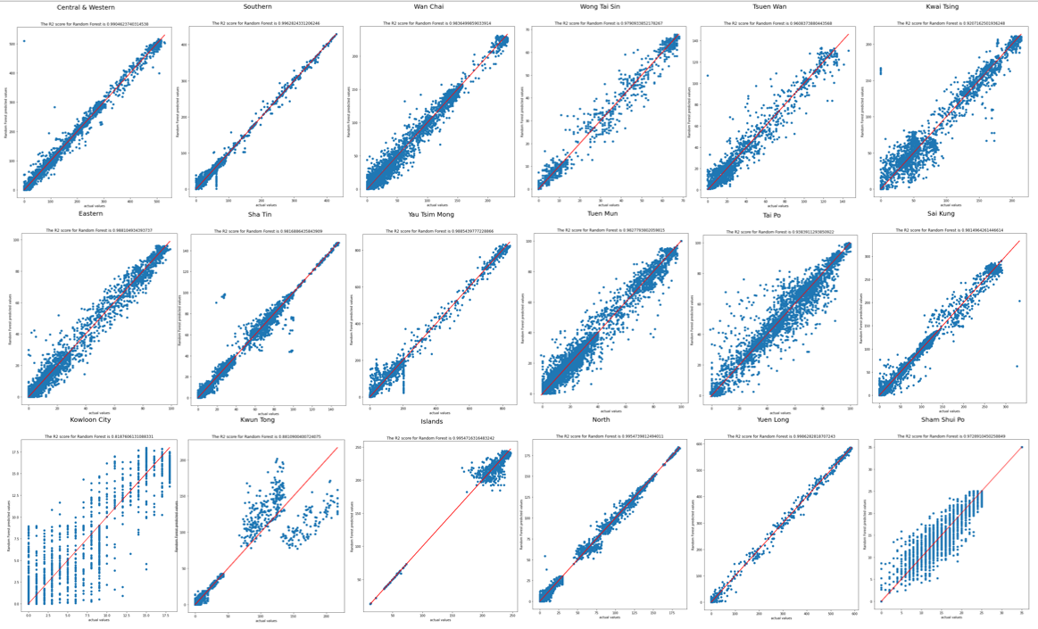
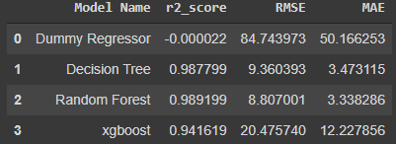
Future Development: Model Selection
Model trained:
Dummy Regressor,Decision Tree,Random Forest, xgboost, GridSearchCV
Best accuracy model (Highest R2):
Random forest
Best result metrics:
R2 Score = 0.989
Mean-absolute error = 8.807
Root-mean-squared error = 3.338
Random Forest R2 score for 18 districts

Slide 33
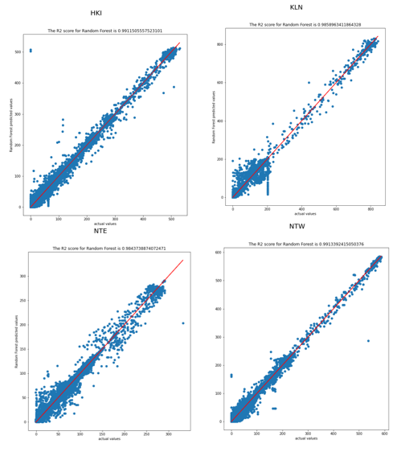
Future Development: Model Selection
Model Selection as district or zone
Solution:
Train model with zone
R2 score will be compared for district inputted by user
Zone or district model of random forest will be deployed based on higher R2 score of district selected
Conclusion:
Districts in HKI, NTW, NTE → corresponding zone model will be used
Districts in KLN → Hong Kong (ALL) model
Random Forest R2 score for 4 zones
Hong Kong Island | RMSE: 8.611 | R2:0.991 | MAE:3.542
Kowloon | RMSW: 13.242 | R2:0.986 | MAE:3.955
N.T. West | RMSE:7.895 | R2:0.991 | MAE:3.557
N. T. East | RMSE:5.997 | R2:0.984 | MAE:2.607
Hong Kong (ALL) | RMSE:8.797 | R2:0.989 | MAE:3.338

Slide 34
Future Development: Model Selection
Hong Kong Island | Central & Western, Southern, Wan Chai, Eastern
Kowloon | Sham Shui Po, Wong Tai Sin, Kowloon City, Kwun Tong, Yau Tsim Mong
New Territories (West) | Islands, Tsuen Wan, Kwai Tsing, Yuen Long, Tuen Mun
New Territories (East) | Tai Po, Sai Kung, North, Sha Tin
Zone
Created by grouping districts
Model Selection by zone
Problem:
Some district have relatively low R2 score
(as seen in previous result slide)

Slide 35


Future Development: Hyperparameter Tuning
 | Implement | Level of Understanding | Credibility/Accessibility
GridSearchCV |  | Easy to understand | Provided by Sklearn
RandomizedSearchCV |  | Easy to understand | Provided by Sklearn
Bayesian Search |  | Certain level of understanding to Bayesian Theorem | Accessible but may not be reputable
Genetic Algorithm |  | Must be familiar to genetic algorithm | No reputable packages online

Slide 36
Future Development: Hyperparameter Tuning
Combo!!! | Implement | Level of Understanding | Credibility/Accessibility
GridSearchCV |  | Easy to understand | Provided by Sklearn
RandomizedSearchCV |  | Easy to understand | Provided by Sklearn
Bayesian Search |  | Certain level of understanding to Bayesian Theorem | Accessible but may not be reputable
Genetic Algorithm |  | Must be familiar to genetic algorithm | No reputable packages online

Slide 37
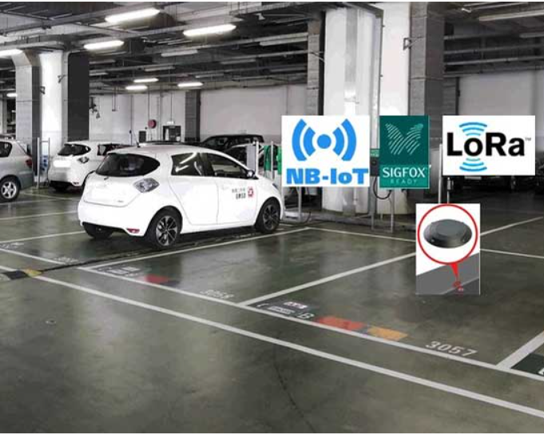
Future Development: Enhancing Prediction Accuracy
Trying more methods in the data preparation process:
More data
More external data for feature engineering
Normalizing, Logarithmic, Box Cox Transformation , etc.
Live vacancy data from EMSD smart car park management
Remove outliers/Unbalanced (prevent bias)
Hong Kong EMSD smart car park management

Slide 38
The End

Slide 39
Q & A~

Slide 40
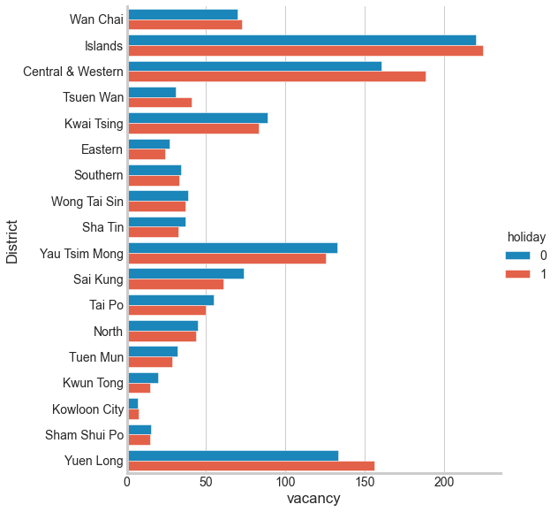
Exploratory Data Analysis
Figure
vacancy (by holiday’) per districts
Findings:
No difference
Affected by COVID-19 ?

Slide 41
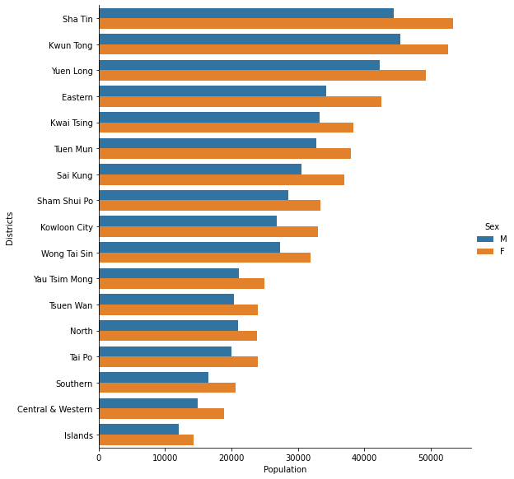
Exploratory Data Analysis
Figure
Population and gender distribution of each district
Findings:
Find no district has any exceptionally disproportionated M-to-F ratio

Slide 42
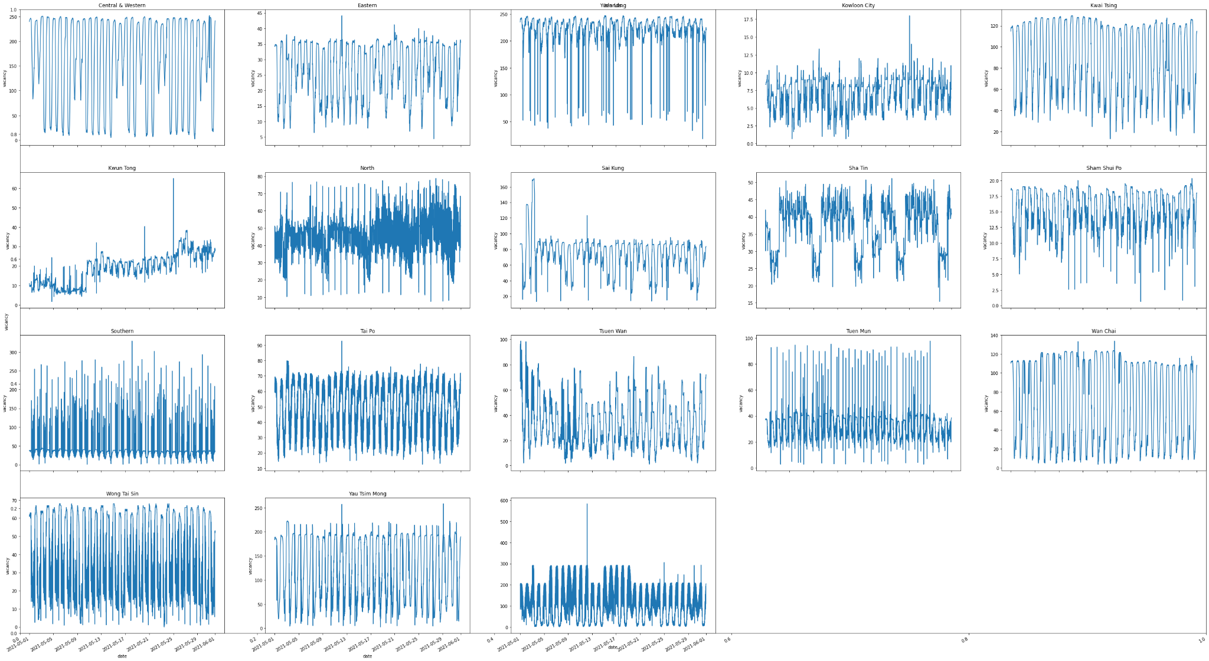
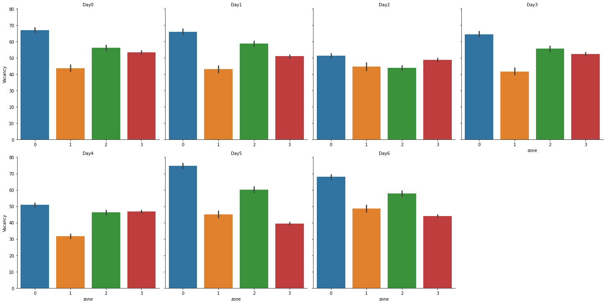
Exploratory Data Analysis
Figure
mean vacancies - date
per district
Findings:
Parking vacancies periodicities mostly vary in stable manner
This shows no correlation between vacancy and date
Parking vacancies does not vary much with day
Notes:
We also tried to plot mean vacancies vs date per district

Slide 43
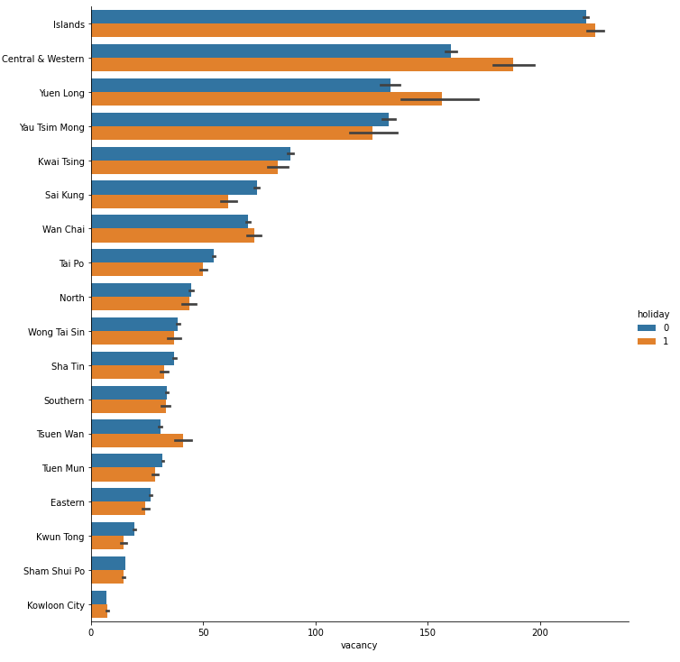
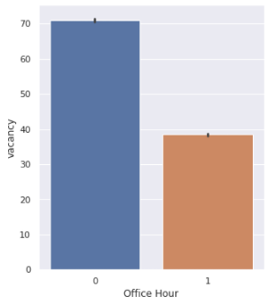
Exploratory Data Analysis
Figure
vacancy in office hour (9:00 - 18:00)
Findings:
mean vacancy during non-office hour: ~ 70 office hour: ~40
greater by a factor of ~2
Not much diff. By districts

Slide 44
Exploratory Data Analysis
Figure
Vacancy by (Tesla SuperChargers) per District
Findings:
Wan Chai: only district provide slots with Tesla Superchargers.

Slide 45
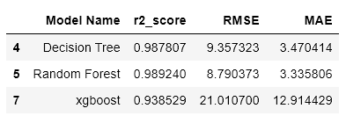
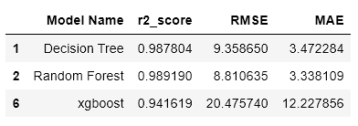
Base Dataset vs Base Dataset w External Dataset

